Slide 1
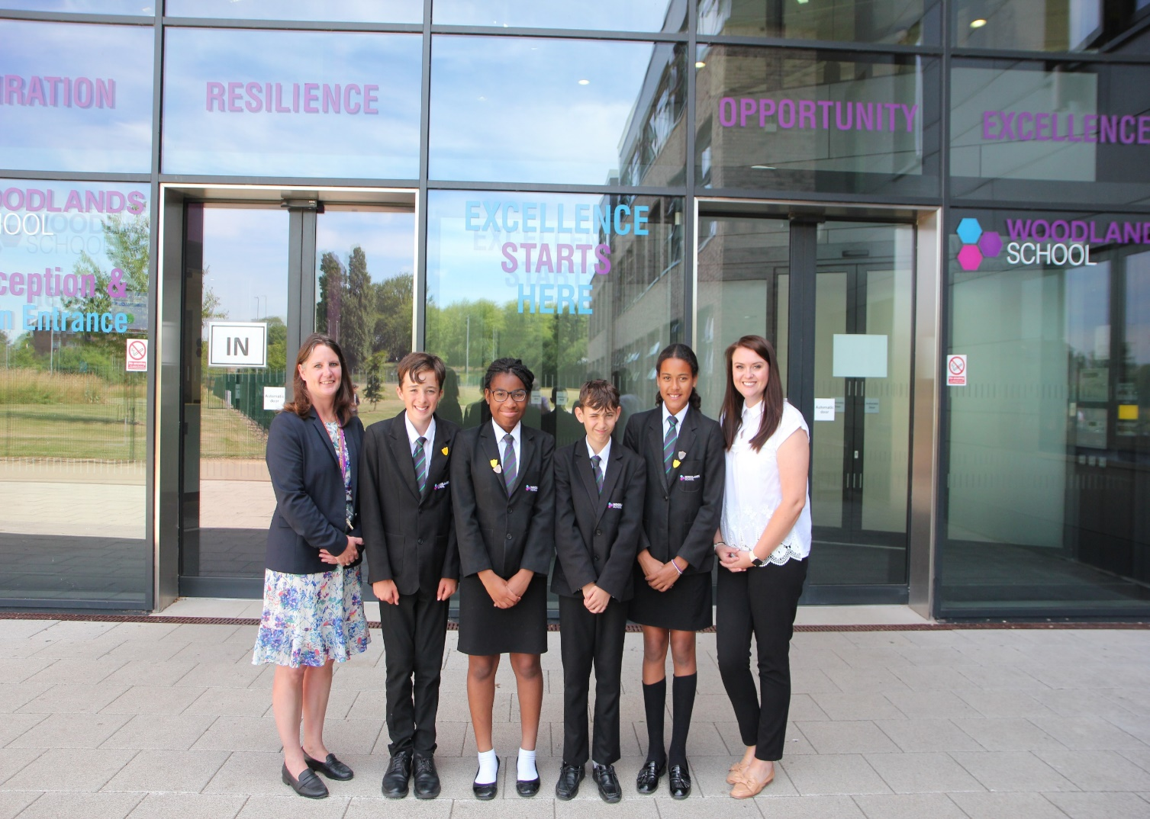
Welcome to Woodlands School

Slide 2
Five Golden Rules
Attend every day and every lesson on time
Look smart and wear your uniform with pride
Be polite and respectful to all
Work hard and always try your best in all aspects of school life
Always be equipped for learning, every day, every lesson

Slide 3
Uniform
Jewellery
One pair of plain studs
Small
Metal (Gold or Silver)
Nothing valuable
No other jewellery
School Shoes
THEY MUST BE SENSIBLE BLACK LEATHER SHOES.
No trainers
No canvass
No Boots

Slide 4
Uniform
Hair
No shaved patterns
No tramlines
No extreme colours
No extreme styles
Make up/ Nail Polish
NO MAKE-UP/NAIL VARNISH TO BE WORN BY YEAR 7’S
Tutor will check

Slide 5
Electronic Devices
Mobile Phones & Airpods/ Headphones:
The use of mobile phones/ airpods/ headphones are not permitted inside the school building. Devices can be used outside in pupils’ free time only.
They should not be visible in blazer top pockets during lessons or lesson changeover.
During PE lessons, pupils may place valuables in the safety box and are not to leave items unattended in the changing rooms.
The school cannot be responsible for the loss or damage to mobile phones/ airpods or headphones.

Slide 6
Daily Equipment/School Bag
Pens
Pencils
Ruler
Scientific calculator
Reading book
Sharpener/Rubber
Glue Stick (optional)
Highlighter (optional)

Slide 7
Lockers
One for everyone if wanted
Secure
Must bring own padlock
Don’t have to carry everything all day
£5.00 annual charge payable via ParentMail
Must be emptied and padlock removed at the end of each year

Slide 8
Cashless System
Thumb image
Used in the canteen (Atrium)
£5.00 limit per day unless you set otherwise
Pay for food and drinks using thumb image
Parents/carers can see via ParentMail what has been purchased – Not lots of cakes!
Topped up by parents/carers using ParentMail
Packed lunch in atrium
Supervised

Slide 9
Our School Day
8.40am – Onsite
8.45am - 9.00am Tutor period
9.00am - 10.00am Lesson 1
10.00am - 11.00am Lesson 2
11.00am - 11.20am Break time
11.20am - 12.20pm Lesson 3
12.20pm - 1.20pm Lesson 4
1.20pm - 2.00pm Lunchtime
2.00pm - 3.00pm Lesson 5
3.00pm End of school day (extra curricular or period 6 begins)

Slide 10
Late Detention
If pupils after 8.45am, their name will be recorded by one of our Attendance Officers and they will be sat a same day 15 minute detention from 3-3.15pm.
If pupils fail to attend the 15 minute detention this will be escalated to a 30 minute detention the following day. Repeated non-engagement with late detentions will escalate to 1 and 2 hour sanctions and inclusions where necessary. Parents will be notified by the school.
If pupils arrive late to lesson, minutes will be accumulated throughout the day and pupils will make back the time at the end of the school day from 3pm.
Punctuality is an important life skill!

Slide 11
ePraise Reward System
Our online reward system www.epraise.co.uk or via the app
Awarded reward points for Aspiration, Resilience, Opportunity and Excellence
ePraise points will be awarded to all aspects of school life; attendance, positive behaviour in & out of the classroom, effort & attainment in lessons, participation in extra-curricular opportunities (clubs, pupils leadership roles, trips & visits)
Bronze, Silver and Gold AROE badges can also be achieved alongside our Cultural Capital Badge

Slide 12
House System
Top universities: Oxford, Cambridge, St Andrews, Durham, Loughborough & Bath
7A1 & 7R1 – University of Oxford
7A2 & 7R2 – University of Cambridge
7A3 & 7R3 – University of St Andrews
7A4 & 7R4 – Durham University
7A5 & 7R5 – Loughborough University
7A6 & 7R6 – University of Bath
There will be a house captain and 2 deputy house captains in each year group
Competitions between houses will take place during curriculum lessons throughout the year, and also through sports day

Slide 13
Literacy: DEAR time
Throughout years 7 to 9, pupils will take part in DEAR time – Drop Everything and Read.
This will take place once a week, for 20 minutes in the timetabled lesson.
All pupils are expected to read their reading book brought in with them.
Date and lesson
Monday 12th September – Period 1
Monday 19th September – Period 2
Monday 26th September – Period 3
Monday 3rd October – Period 4
Monday 10th October – Period 5
Tuesday 18th October – Period 1

Slide 14
Y7-9 Curriculum

Slide 15
Home Learning RAW Knowledge/ Tassomai
All pupils complete homework for all of their subjects via RAW Knowledge (Retrieval at Woodlands).
This is a quizzing programme designed in collaboration with the people who make Tassomai, to improve pupils long term memory. It can be accessed via a computer/phone app.
Questions are ‘pitched’ to the learner. Questions are assigned a difficulty level based on all students’ performance on the question itself.
Pupils will have three daily targets every day, one per bucket (they will receive questions from a range of subjects within each bucket):
Bucket 1- Maths, English
Bucket 2- Science, Humanities, MFL
Bucket 3- Creative Arts, Technology, Athletic Performance
Pupils need to achieve 50 points in each bucket.
Pupils may be set additional tasks to complete for homework by individual teachers, and this will compliment RAW Knowledge. This will be set on Microsoft Teams.

Slide 16
Assessment & Reporting
Assessments & Reports can be accessed online via PAM
Similar to Primary School model grades:
Working Towards
Expected Standard
Greater Depth
Focusing on what each individual knows, what they need to improve on and how that can be done
Assessed each half-term

Slide 17
PAM
Online system
Login with email address provided to the school
Shows timetable as well as academic performance
http://woodlandsschool.org/pam/

Slide 18
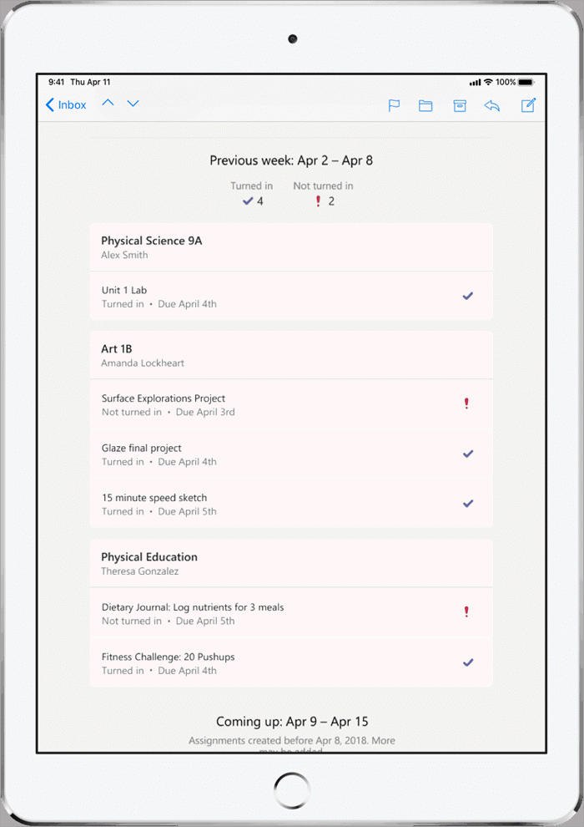
What is Microsoft Teams?
The majority of pupils’ homework will be set via Tassomai.
However, particularly in older years, pupils might be set specific homework assignment on Microsoft Teams.
Teams can also be used to share revision resources with pupils or for classes to discuss their learning.
You can also log into the Microsoft Teams app, using your child’s account details, to view your child’s assignments at any point.

Slide 19
How does my child log into Microsoft Teams?
Your child may have already downloaded this as a programme on their PC/laptop. If not, they can access Teams online. To do so, they should follow these instructions:
Go to https://www.office.com/ (you can also find this page by searching ‘Office365’ on Google)
Click on, ‘sign in.’
Sign in using your school e-mail address and password.
You will be taken to the Office365 home page. On the left-hand side, you will see a column of icons. Scroll down and click on the icon that is purple with a T that looks like this:
Click on, ‘use the web app instead’.
You will now be logged into Microsoft Teams

Slide 20
How does my child turn in their remote learning on Microsoft Teams?
To watch an instructional video, click here: How to Check and Turn in Homework Assignments on Microsoft Teams
(Tutors: you don’t need to show this now – but you can click on this link when the presentation is sent out to parents/carers.)

Slide 21
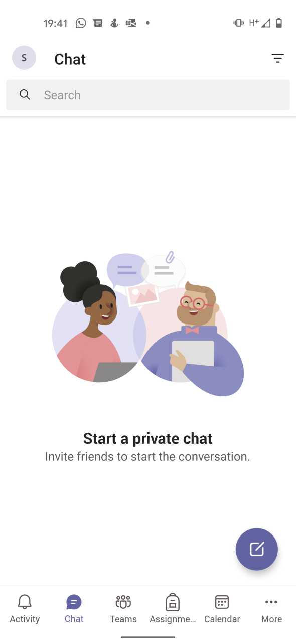
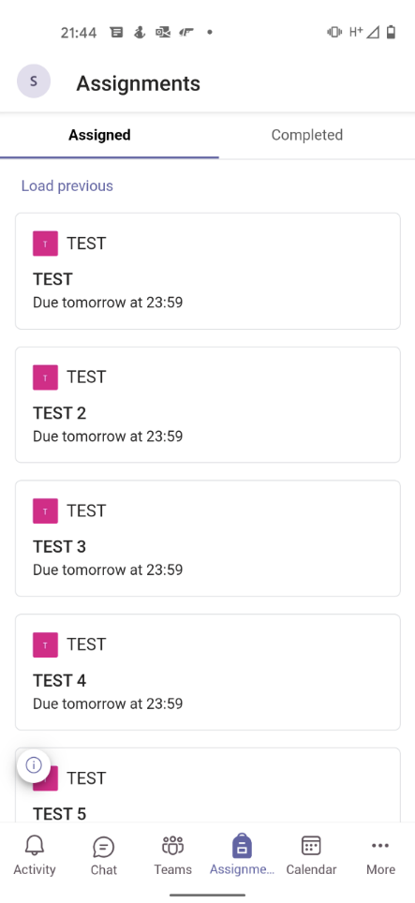
How do I check what homework my child has on Teams?
You can check Teams whenever you want by logging into your child’s Teams account on a laptop, or by downloading the Teams app.
Click on the assignments button at the bottom of the screen.
You will see the list of the assignments set. The assignment due in soonest will appear at the top of the list.
On the top right, click the completed button to see homework assignments that your child has completed.

Slide 22
How can I access the Microsoft Teams app?
To log into the Microsoft Teams app:
Go to the Apple Store or Play Store and search for Teams to download.
Click on sign in.
Sign in with your child’s school e-mail address e.g. 21robertse@woodlandsschool.essex.sch.uk
You will be redirected to the RM Unify page, where you will need to enter your child’s school password. This is the password they use on the school computers.
To turn off notifications from Microsoft Teams:
Click on the symbol in the top-left that looks like this (it may have a different letter in the middle of the circle):
Click on notifications.
Click on general activity.
You can decide to turn Teams’ notifications on or off.

Slide 23
Further Support
If your child does not have a laptop/tablet/PC to work from at home, the school can loan a device. E-mail ero@woodlandsschool.essex.sch.uk if you did not complete the survey sent out.
If you have technical issues, please e-mail ero@woodlandsschool.essex.sch.uk
To watch an instructional video, click here: How to Check and Turn in Homework Assignments on Microsoft Teams
To find out how to download Microsoft Office for free, click here: How to Downloads Microsoft Office for Free

Slide 24
Anti-Bullying
No bullying of any kind will be tolerated
We have an Anti-Bullying Textline
Reported to Head of Year
Action taken
07519361717 – Text line

Slide 25
Attendance
Attendance and punctuality have a high profile at Woodlands
Expectation for pupils to attend every available session
Attainment strongly linked to attendance, 1 days absence equates to 5 hours of lost learning
We work collaboratively with parents/carers to remove any barriers to learning
We also work with the local authority and partners where necessary
Routine medical appointments should be made outside of school hours

Slide 26
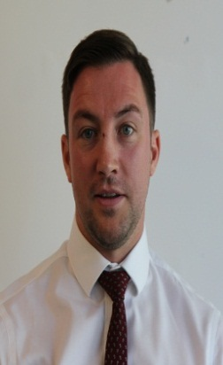
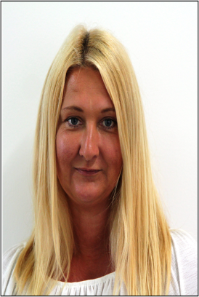
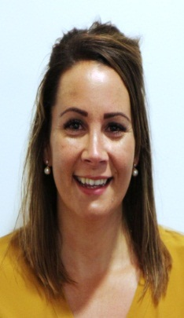
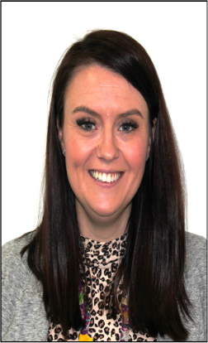
Safeguarding at Woodlands
To safeguard our whole community, we do not tolerate:
Bullying
Any form of abuse
Any form of harassment
Making someone feel uncomfortable
The sending of hurtful or unwanted messages/ images
We will:
Listen
Take all worries or concerns seriously
Be non-judgmental
Support you
Never keep a secret, but always act in your best interests
Consider your wishes and feelings
Mr Riste
Assistant Headteacher
Designated Safeguarding Lead
Janet Clarke
Deputy Designated Safeguarding Lead
Years 8 and 9
Donna May
Deputy Designated
Safeguarding Lead
Years 10 and 11
Luka Atkinson
Deputy Designated Safeguarding Lead
Year 7, LAC, Head of transition
Why?
School relationships based on respect, friendship, tolerance and kindness
The Safeguarding Team are located in the library (glass office)/ DRi office opposite Pupil Services
Speak out – Report to any member of staff. Everyone’s responsibility. All staff duty of care.

Slide 27
Top Tips
Follow the Woodlands Way
Smile and be friendly
Make new friends
Be positive
Be smart and prepared
Take up all opportunities open to you
Just relax and be yourself!

